Slide 1
Improve Sites with Liferay DXP’s Modern Tools
Liferay DXP Basics
Business
Liferay DXP 7.4

Slide 2
Key Module Takeaways
Content Pages can combine fragments and widgets to create dynamic and engaging web pages.
Master Pages and Style Books provide ways to ensure consistent page experiences by defining common page elements or applying a set of visual rules.
Experiences and Responsive Layouts help create a unique, optimized User experience on a Site.
Integrating Digital Signature, Click to Chat, and Automatic Translation helps improve User support on Sites.

Slide 3
Exercise Prerequisites (1/2)
Unzipped module exercise files in the following folder structure:
Windows: C:\liferay
Unix Systems: [user-home]/liferay
Liferay DXP 7.4 set up and running
If you have not started your Liferay instance yet, set it up with the following basic configuration:
You should also have at least one additional User, Naomi Engel, created.
Portal Name: Mondego
First Name: Test
Last Name: Test
Email: test@modego.com
Notes:
For more on creating Users, consult the Add Users and Manage Permissions module.
Check out the Liferay Foundations: Introduction to Liferay DXP course if you have questions on starting a new instance of Liferay DXP.

Slide 4
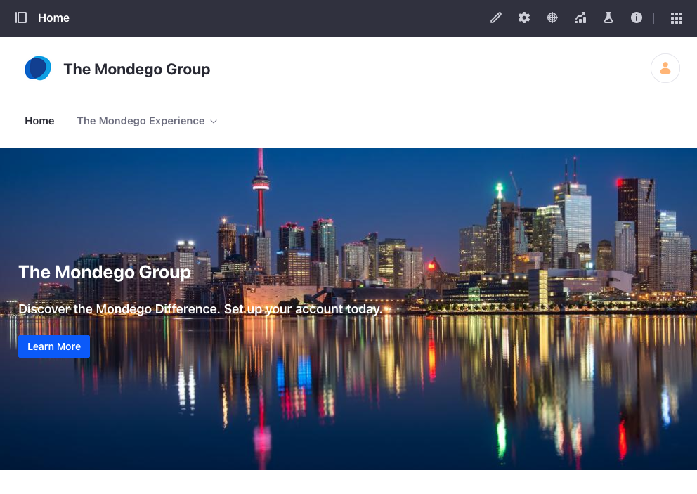
Use Case: The Mondego Group
The Mondego Group wants to improve and streamline User experiences on several of its customer facing Sites. To do so Mondego needs:
The ability to quickly create pages using materials created by the development team
Consistent styling across multiple pages and Sites
Notes:
(Add Image)

Slide 5
Use Case: The Mondego Group
Mondego also wants to improve Customer Service by adding:
Unique User Experiences for different customers and user groups
A click to chat feature to allow Users to chat with Customer Service
A secure way for Users to sign documents
Automatic Translation for web content
Notes:
(Add Image)

Slide 6


Relevant KPIs for Module
Decrease the amount of time spent styling pages and Sites
Increase User engagement by creating Experiences and improving Site navigation and mobile compatibility
Improve response time to User questions by integrating Click to Chat functionality
Reduce time spent translating web content by enabling automatic translation

Slide 7
Using Content Pages and Fragments

Slide 8
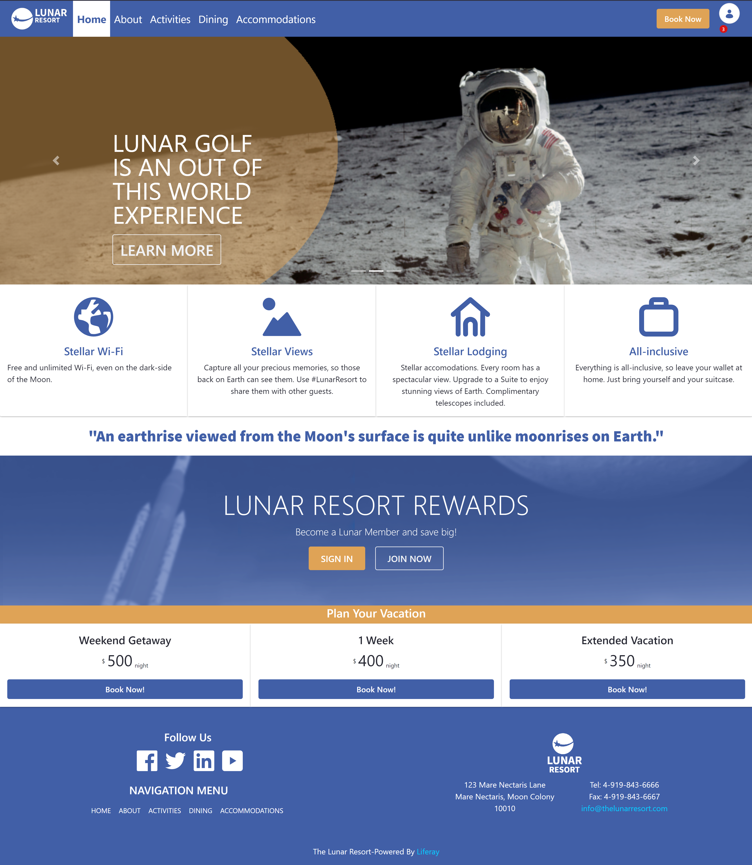
Content Pages
Content Pages are the default page type in Liferay DXP
The Editing UI contains drag-and-drop elements in the Fragments and Widgets tabs
Content Pages are designed to be used with minimal configuration and have two main editing modes:
Page Design
Content Editing
Notes:
Notes:
Widget Pages are still available in DXP 7.4 and may be selected for pages with specific purposes (e.g., a Page using the Blog Template, a Widget Page). Widgets are not limited to Widget Pages, however, and can easily be added to Content Pages.
Use Case:
Since these are the default page type, most of the pages on Mondego Sites will be Content Pages. Content Pages still allow the Web Team to add necessary widgets, but they also allow for easy editing and design.

Slide 9
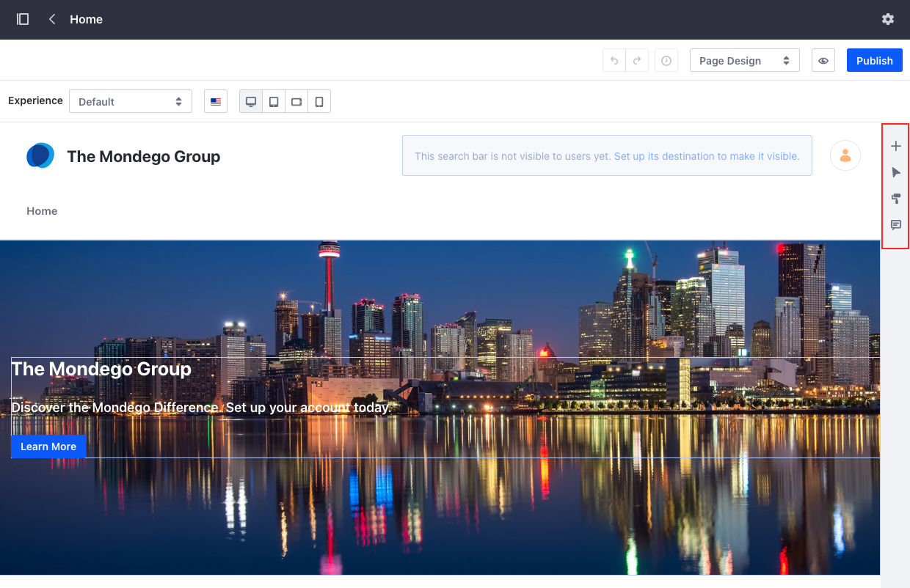
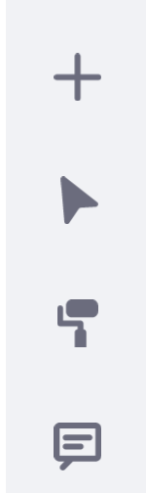
Page Design
The Page Design editing mode contains the following action elements:
Fragments and Widgets
Browser
Page Design Options
Comments
Notes:
Notes:
These buttons open four distinct parts of the menu (we’ll discuss these in greater detail):
Fragments and Widgets: contains all available Fragments and Widgets
Browser: provides options related to page elements and page content as well as general and style features for elements
Page Design Options: includes options to set Master Page and Style Book
Comments: allows Users (with permission) to add comments to specific fragments
Page Design is the default editing option. In Page Design, Users have the option to edit and change the page layout, add or revise content, and add Fragments and Widgets.

Slide 10
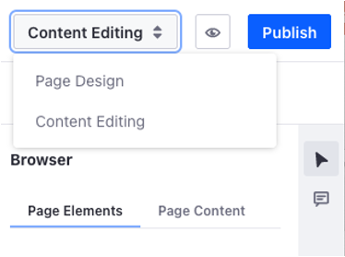
Content Editing
The Content Editing mode contains two of the action elements seen in Page Design:
Browser
Comments
Content Editing allows Users to edit content on a Page without impacting the layout
Users granted permission to Update Page Content can add or edit Content and add Comments
Notes:
Notes:
Content Editing is useful for working just with the content. Layout cannot be changed in Content Editing, and new Fragments and Widgets cannot be added.
Content Editing also allows other Users to manage the content without granting them unnecessary permissions. Granting an editor the Update Page Content permission allows the editor to revise and update text on a page without allowing them to modify the layout or Fragments included on a page.
Comments can also be used in Content Editing mode
Use Case:
Though the Mondego Web Team manages the design and layout of Pages, other Users may need to add content to various pages on the Site. Mondego has a Content Creator role created for these Users, so the Web Team can grant the Content Creator role the “Update Page Content” permission on the Pages that need content. This allows the Content Creators to focus on adding relevant content to the Pages.

Slide 11
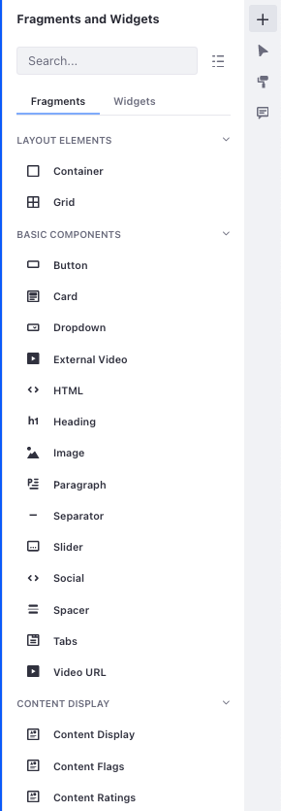
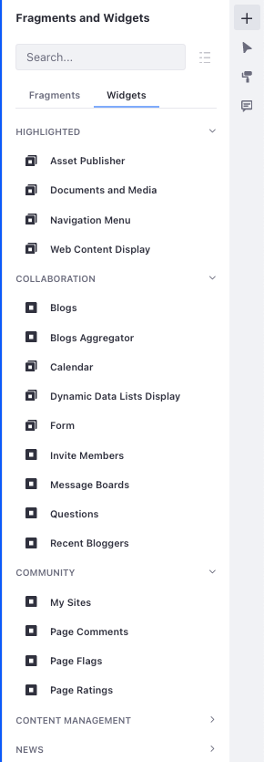
Fragments and Widgets
The Fragments and Widgets section contains drag-and-drop elements used to build content
Fragments: Predefined segments that contain editable elements including text, images, or links
Widgets: Applications that can be added to a page
Notes:
Note:
Fragments:
These are the primary building blocks of Content Pages. The editable elements (text, links, etc.) in Fragments can be replaced with custom content directly on the page or mapped to existing Site content in the Browser sidebar
Widgets:
Widgets can be added to Content Pages much in the same way they are added to Widget Pages, though some configuration options are not available for Widgets on Content Pages. (e.g. Look and Feel Configuration is not an option for Widgets on Content Pages, though many of the settings can be managed in the Browser under General.)
While a large variety of both fragments and widgets are available out-of-the-box in Liferay DXP, custom fragments and widgets can be created to further adapt the platform to the desired look and feel for your business.
Use Case:
The flexibility of Content Pages allows the Mondego Web Team to create well-designed pages with a variety of content. The team can quickly drag and drop elements to design a page and get a sense of the appearance and layout before populating it with content. Fragments also allow the team to directly add and edit page elements with or without mapping it to existing content.

Slide 12
Out-of-the-Box Fragments
Out-of-the-box, Liferay DXP contains the following Fragment types:
Layout Elements: define drop zones and provide organizational structure
Basic Components: simple elements that add basic functionality
Content Display: display Site content individually or as a collection
Cookie Banner: displays a banner for cookie acceptance
Featured Content: multi-part fragments that display prominent content
Footers: fragments that serve as page footers and navigation bars
Navigation Bars: fragments that serve as headers and navigation bars
Menu Display: fragment used to add a menu bar anywhere on a page
Notes:
Notes:
Layout Elements include Container and Grid.
Basic Components include elements like Button, Card, Paragraph, Image, and more.
Content Displays should not be confused with Content Management Widgets, though there are some similarities. Content Displays can feature single content item or a collection.
The Cookie Banner adds a notification that the Site uses cookies and prompts the User to Accept. Cookies are managed and enabled in the Control Panel.
Featured Content includes Banners, Features, and Highlights.
Footers and Navigation Bars are used to set Footers and Headers for a Page. Additional or alternate navigation menus can be added to these bars.
Menu Display adds another navigation menu based on the Site’s Public or Private Page hierarchy, managed by setting the menu Source.
Use Case:
The Mondego Web Team can easily create a dynamic landing page for the main Site using these Fragments. For instance, a Banner fragment can welcome guests and prompt them to sign in or create an account. Using. Grid component, they can set a row of Cards with information about specific account types. They can add a unique Footer with a distinct menu for contact information, FAQs, Career options, and more.

Slide 13
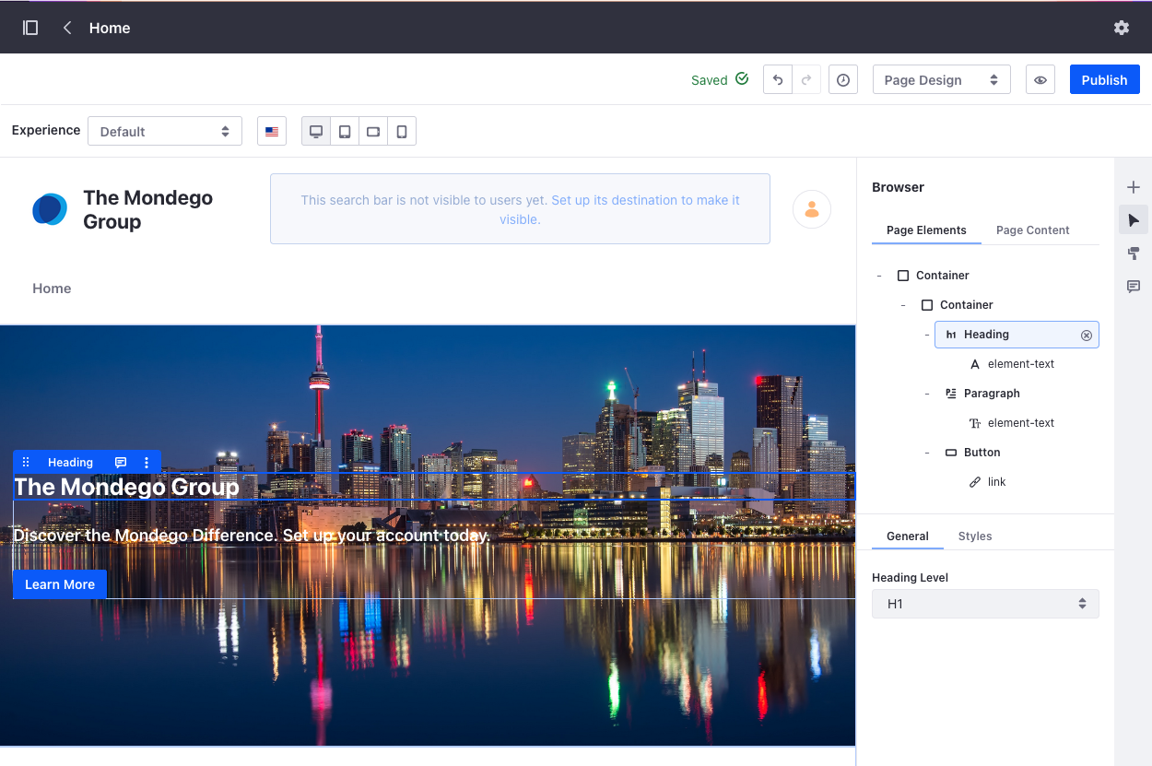
Configuring Fragments
Many fragment elements can be edited directly from the UI, including:
Styles
Text
Hyperlinks
Images
Layout
Fragments can also be configured to Show or Hide on different devices
Notes:
Notes:
Editable fragment elements can be selected either by clicking directly on the element or by locating the element in the Browser sidebar. For example, to change the heading in the image, either click the text box directly or use the sidebar to select the Heading.
The Styles tab in the Browser includes Layout, Margin, Padding, Size, Text, Background, Borders, and Effects.
The Text element allows you to either directly edit the text (which brings up a text toolbar) or to map an Item to the textbox.
The Link element allows you to manage link type, source, and whether it opens in a new tab.
Images allows you to add an image, including as a background.
The Layout of the page can be managed either directly on the page or by reordering elements in the Browser sidebar.
Edited fragments can be duplicated or saved for future usage
Under the styles tab, there is an option to “Hide” the fragment for the selected screen size/device type. If a fragment should be hidden on mobile, for instance, click the Phone or Tablet options at the top of the editing UI and then check the “Hide Fragment” box under Styles.
Use Case:
Mondego has a Fragment that contains a link for downloading the Mobile Banking App on its main Banking Site. Since this Fragment is not needed for the Desktop Site, they can select “Hide Fragment” for the Desktop version so that the fragment only appears on Mobile or Tablet devices.

Slide 14
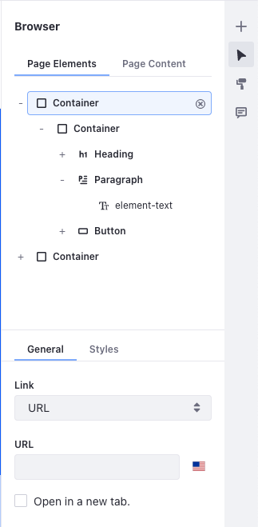
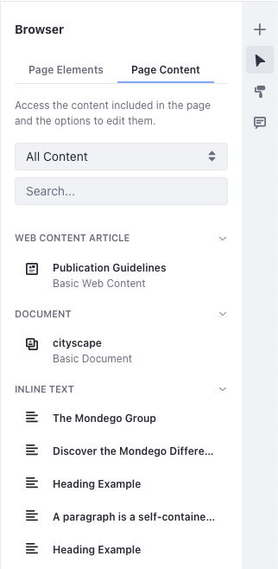
Browser
The Browser sidebar is used to manage the content on a Page and contains two tabs
Page Elements hierarchically displays all elements on a page
Additional tabs, including General and Styles, may appear depending on the selected element
Page Content lists all content on the page and allows actions, such as editing and managing permissions, to be performed
Notes:
Notes:
The Browser serves as a primary overview of the content on a page and allows for easy content management.
The Page Elements tab includes an outline of the current page layout. Selecting an element also shows any General and Styles features that can be applied to the element.
The Page Content tab lists all content on the page, allowing for easy editing and permission management.
Use Case:
If a Mondego Page Creator needs to quickly see the specific elements and content on a Page and apply styles, they can use the Browser to quickly navigate to the appropriate element.

Slide 15
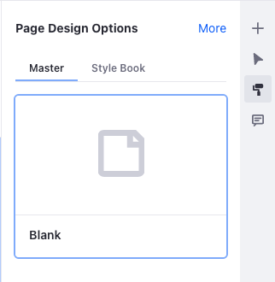
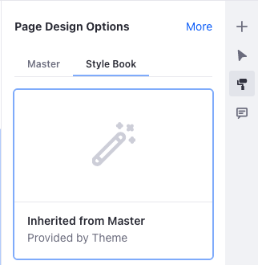
Page Design Options
The Page Design Options section includes two tabs with options that can be applied to a Page to define overall style and layout:
Master: lists all available Master Pages
Style Book: lists all available Style Books
Additional Page Design settings, including Look and Feel and Advanced settings, can be accessed by clicking More.
Notes:
Notes:
Content Pages will automatically use the default Master Page (usually Blank) and Style Book. Once a new Master Page Template or Style Book has been created, they can be set as the default and will automatically apply to any new Content Pages.
(More on these in the next lecture)
Use Case:
To maintain a consistent appearance and style across Pages, the Mondego Web Team can create and apply Master Page Templates. These contain a set Header, Footer, and company logo. The team also created a Style Book to apply appropriate Themes across the Site and can manage that in the Page Design Options section.

Slide 16
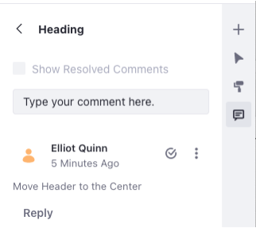
Comments
Comments are annotations that can be added to Fragments without altering any of their contained content
Comments can be used to:
Facilitate team member collaboration while creating Content Pages
Notify specific individuals of suggested page updates using the Mentioning Users feature
Notes:
Notes:
Mentions must be enabled in order to tag Users in the comment. This is managed in the Control Panel > Instance Settings > Community Tools or at the Site scope under Configuration > Site Settings > Community Tools. Users are then mentioned by using the @ symbol and the User’s username.
Keep in mind, the mentioned User must have the proper permissions to view the comment.
Use Case:
Comments are especially useful for the Mondego Web Team, since they allow other (approved) Users to review a Page and leave input without accidentally changing the layout or Fragments on the page.

Slide 17
Use Case Example: Creating Pages Collaboratively
To create dynamic, engaging pages for the Mondego Site, the web team uses Content Pages. Content Pages give them flexibility and speed in page creation, especially when they need to work collaboratively.
The Mondego Web Team includes Users with different roles and task assignments, such as page designers and content creators:
The page designers use Fragments in Page Design mode to quickly build the envisioned page.
Content creators are granted the Update Page Content permission and use Content Editing mode to directly add content to the page and can leave comments on Fragments for the page designers.

Slide 18
Knowledge Check
The Mondego Web Team creates Content Pages by dragging and dropping fragments and widgets onto the page.
Mondego Content creators can edit content inline using Content Editing mode, while the Page creators can manage the design and layout in Page Design mode.
The Mondego web team can use the Browser sidebar to easily navigate the hierarchical arrangement of elements, fragments, and content and to manage styles, permissions, and other settings.
Mondego’s Content Creators can leave Comments on specific elements on a page to give Page Designers feedback on the layout.

Slide 19
Knowledge Check
The Mondego Web Team creates Content Pages by dragging and dropping fragments and widgets.
Mondego Content creators can edit content inline using Content Editing mode, while the Page creators can manage the design and layout in Page Design mode.
The Mondego web team can use the Browser sidebar to easily navigate the hierarchical arrangement of elements, fragments, and content and to manage styles, permissions, and other settings.
Mondego’s Content Creators can leave Comments on specific elements on a page to give Page Designers feedback on the layout.

Slide 20
Exercise: Create Content Pages

Slide 21
Create Content Pages Exercise Objectives
Create the Mondego Community Site
Add a Content Page to the Mondego Community Site
Edit the Content Page using the Site Content Creator Role

Slide 22

Creating Content Pages Exercise Steps (1/2)
Create the Mondego Community Site
Add a Content Page to the Mondego Community Site
Add Fragments and Widgets to the Content Page
Configure the Slider Fragment
Configure the Highlights Fragment
Hide the Slider Fragment on Mobile Devices
Configure the Asset Publisher Widget

Slide 23
Creating Content Pages Exercise Steps (2/2)
Add a Comment to the Slider Fragment
Manage Mentions for the Mondego Platform
Assign Naomi Engel the Site Content Creator Role
Define the Site Content Creator Role Permissions
Sign In as Naomi Engel
Edit the Content Page as Naomi Engel
Add Images to the Highlights Fragment

Slide 24

Creating Content Pages Bonus Exercises
Add two more Content Pages, called "Join the Community" and "FAQ." Add at least two Fragments of your choice to each page and adjust the settings for at least one fragment to Hide or Show on different devices.
Grant the Site Content Creator Role to another User and edit the Fragments of the Welcome Page as that User. Add text to the three paragraph elements in the Highlights Fragment.

Slide 25
Using Master Page Templates and Style Books

Slide 26
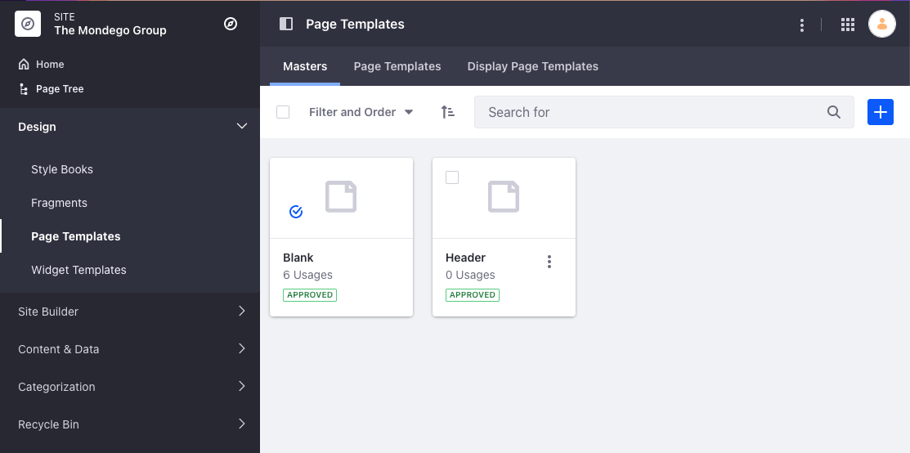
Master Page Templates
Master Page Templates are a way to define common Page elements with Fragments
Master Pages remove the need to deploy plugins to maintain and manage elements like Headers and Footers
Every Page and Page Template on a Site must be associated with a Master Page Template
Notes:
Notes:
While each Page or Page Template on a Site must be associated with a Master Page Template, individual Pages/Page Templates on the same Site can be associated with different Master Page Templates.
By default, all Pages/Page Templates are associated with the “Blank” Master Page Template which simply provides a blank page with no propagated commonalities.

Slide 27
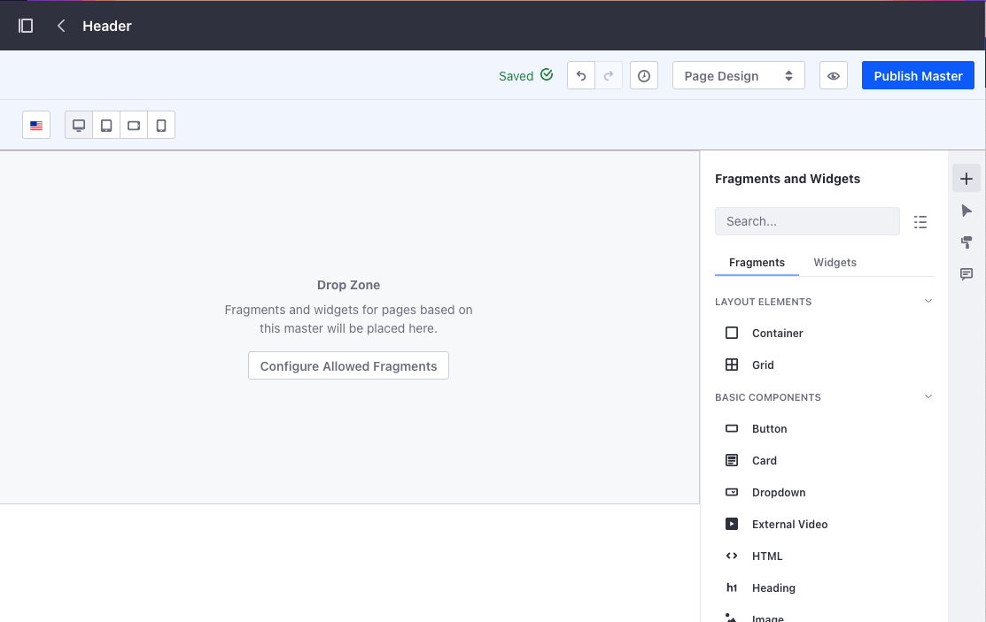
Creating Master Page Templates
Custom Master Page Templates are created from the Design section of the Site Menu
Page Fragments designated as common elements can be dragged-and-dropped onto the page
The Drop Zone defines where elements will be added when Pages use the Master
The Configure Allowed Fragments button is used to specify which types of Fragments can be added
Notes:
Notes:
Typically, Master Page Templates are used to define a Header and a Footer for Pages. The Drop Zone, then, provides a placeholder defining where Fragments can be added to Pages that use the Master Page Template.
The Configure Allowed Fragments button opens a list of all available Fragments and provides the option to select or deselect Fragments that can be used on a Page from the Master.

Slide 28
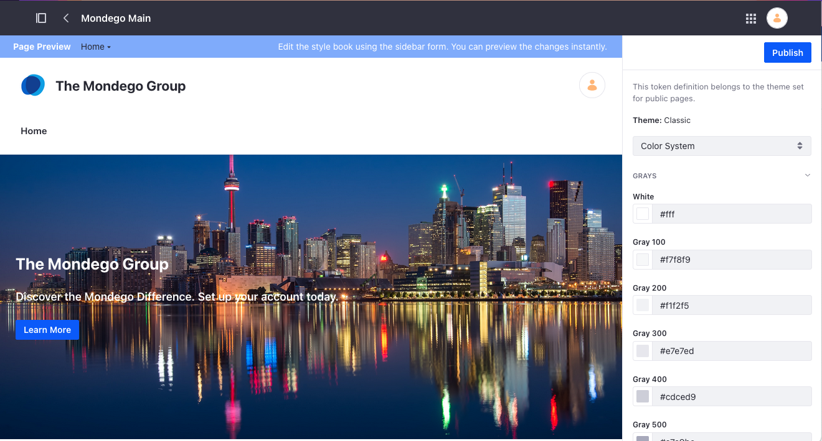
Style Books
Style Books provide a way to alter general aspects of a Site’s look-and-feel without implementing a new Theme, such as:
Color Scheme
Spacing
Layout
Fonts
Notes:
Notes:
Style Books should not be viewed as a replacement for a Theme but rather as a tool to quickly alter a Site’s general appearance within the UI without drastically changing the way it is presented. Style Books can also be created by developers and associated with Themes.
The Sections for Style Books include:
Color System (color theme)
Spacing
General (body, borders, box shadows, aspect ratios, transitions)
Layout (container widths)
Typography (font family, size, etc.)
Button (color, border, link)
Style Books can then be selected and applied to any Page when editing. To apply styles across an entire Site, a Style Book can be set as the default.
Use Case:
Mondego’s design team has decided on a color scheme for all Mondego Sites. To implement this, they can create a Style Book using the selected colors, fonts, and features. This Style Book can then be set as the default and applied to all pages on the Site.

Slide 29
Use Case Example: Creating the Mondego Style
To create a unique Mondego style and apply it across all pages on the Site, the Mondego web and design teams:
Design a set of Master Page Templates to standardize the appearance of different kinds of pages across the Site
Design a Mondego Color Scheme and Style and create a Style Book to implement the Style across all Pages on the Site
With Master Page Templates and Style Books, the team can complete these design tasks without leaving the Liferay DXP UI.

Slide 30
Knowledge Check
Mondego’s web team can create Master Page Templates, which define common groups of fragments for all Site pages.
All Mondego pages and page templates on a Site must be associated with a Master Page Template, even if that template is the default, Blank.
Style Books provide a way to alter Mondego’s Site aesthetics from within Liferay DXP’s UI without needing to deploy a theme, allowing the web team to manage color, fonts, and other design elements.

Slide 31
Knowledge Check
Mondego’s web team can create Master Page Templates, which define common groups of fragments for all Site pages.
All Mondego pages and page templates on a Site must be associated with a Master Page Template, even if that template is the default, Blank.
Style Books provide a way to alter Mondego’s Site aesthetics from within Liferay DXP’s UI without needing to deploy a theme, allowing the web team to manage color, fonts, and other design elements.

Slide 32
Exercise: Establish Site Aesthetics

Slide 33
Establish Site Aesthetics Exercise Objectives
Create a Master Page Template for the Mondego Community Site
Create a Style Book for the Mondego Community Site

Slide 34
Establish Site Aesthetics Exercise Steps
Create a Master Page Template for the Mondego Community Site
Add a Header and Footer to the Template
Update the Images and Content in the Header and Footer
Configure the Allowed Fragments for the Master Page Template
Make the New Master Page Template the Default and Apply it to Pages
Create a Style Book for the Mondego Community Site
Change the Color System and Button Colors for the Style Book
Make the Style Book the Default and View Changes

Slide 35
Establish Site Aesthetics Bonus Exercises
Update the Header and Footer Master Page Template we created on the Mondego Group Site in the Build New Sites Module. Add the Mondego logo to the Header and Footer. Add one more fragment to either the Header or Footer. View the changes on Pages that use the template.
Add a New Style Book to the Mondego Group Site. Adjust the Color System colors to match those on the Mondego Community Site. Adjust Spacing, Layout, or Typography settings. Apply the Style Book to only one page on the Site and view the changes. (You may need to add more content to pages to view some changes.)

Slide 36
Creating Unique Digital Experiences

Slide 37
Adding Personalization and Functionality
Liferay DXP includes several features and tools that can be used to improve your Users' experiences:
Personalized Experiences and User Segments
Customizable Navigation Bars
Responsive Layouts
Newly Integrated Tools in 7.4:
Click to Chat
DocuSign
Automatic Translation

Slide 38
Experiences
Experiences are a way to tailor page content to specific user groups in Liferay DXP
Experiences are unique to Content Pages and are created and applied to a selected User Segment
Notes:
Notes:
Segments are groups of Users. They can be created in Liferay DXP by defining a set of conditions and properties a User must meet to fit in the Segment.
Experiences are also useful for completing A/B Testing, which requires an instance of Liferay Analytics Cloud to collect data.
Some features of experiences and segments are only available or are more tailored if used in conjunction with Analytics Cloud
Use Case:
Mondego can utilize Experiences to create Pages tailored to specific User Segments. For example, the main Home Page features a special offer unique to customers in North America. In order to ensure that only eligible customers access the offer, the team can create an Experience assigned only to the User Segment of North American customers.

Slide 39
Customizable Navigation Bars
Content Pages in Liferay DXP 7.4 have new Fragments that allow Site navigation tools to be added anywhere on the page:
Dropdown: provides a collapsible drop zone for any fragment or widget
Menu Display: provides new options for displaying navigation menus
For Menu Display, the menu is based on the Site’s page hierarchy and can be defined to include only the desired levels.
There are two methods for building a hierarchy in the Menu Display Fragment:
Site Menus: use menus defined in the Navigation Menu for Site navigation
Contextual Menus: show a menu based on Page context
Notes:
Notes:
With these new fragments, it is possible to add a menu anywhere on the page, not just at the top or bottom.
The Dropdown fragment is especially useful for creating Mega Menus without needing to develop a custom theme.
For Site Menus, two menus are provided by default, Public Pages and Private Pages
Contextual Menus allow for more advanced navigation by combining Menu Display Fragments. The options for Contextual Menus include:
Children: shows the children of the current top-level page
Self and Siblings: shows the current page and its siblings
Parent and its siblings: shows the parent of the current child page and the parent’s siblings
Use Case:
Mondego can utilize Customizable Navigation Bars to improve navigation around the Site. For instance, a Page on general investment tips might include a Contextual Menu linking to Pages with similar content, for instance a series of Sibling pages also about Investment and Saving tips and tricks.

Slide 40
Responsive Layouts with Grid and Container Fragments
By default, Liferay DXP uses responsive design:
Out of the box, widgets automatically scale to fit screen size
The Device Display at the top of the page editor simulates screen size so layout can be checked before publishing
Grid and Container Fragments on Content Pages add additional control of the content layout:
With these fragments, specific layout styles can be defined for different screen sizes
Notes:
Notes:
Responsive design by default means that you do not need to create a set of rules to ensure that a web page works on both desktop and mobile. Note that this is not the case for earlier versions of Liferay DXP (7.2 and earlier use Mobile Rules).
The Grid and Container Fragments on Content Pages are particularly useful for customizing Pages to different screen sizes. Using a Container or Grid allows you control the style and layout for each specific screen size (Desktop, Tablet, Landscape Phone, and Portrait Phone).
Use Case:
Mondego knows that many of its Users access the Site on mobile devices. With Grid and Container fragments, the web team can design pages that are visibly

Slide 41
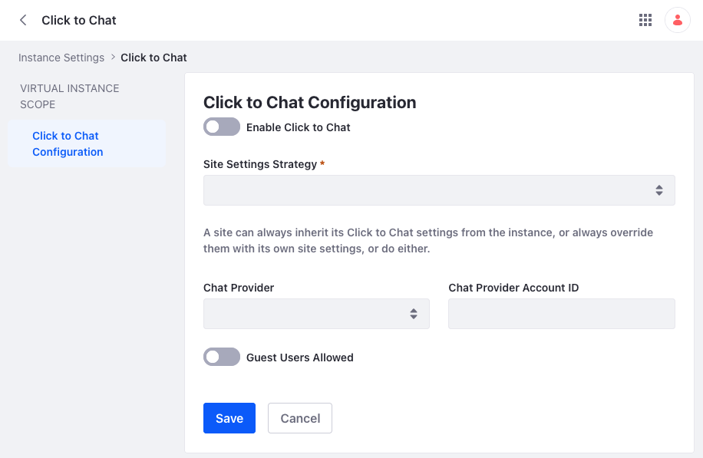
Click to Chat Function
Beginning in Liferay DXP 7.4, it is possible to integrate with live support chat platforms
Enabling Click to Chat adds a chat window to Sites on your Liferay instance to improve support and Site experience for Users
To fully enable Click to Chat, a Site Settings Strategy and Chat Provider and Account ID must be established
Notes:
Notes:
Click to Chat is enabled in Control Panel > Instance Settings > Content and Data > Click to Chat
Once switched to enabled, a Site Settings Strategy and Chat Provider must be selected
An Account ID or token is needed to configure Chat
You also have the option to allow guest users to access click to chat or not

Slide 42
DocuSign Digital Signatures
Also new in DXP 7.4, DocuSign digital signatures can be integrated into documents
Signatures are collected on a Document by selecting Collect Digital Signature, Filling out the Envelope information, and sending it
An envelope is a document or collection of documents to be signed
Signed documents are stored in DocuSign, not Liferay, so downloaded documents must be fetched from DocuSign
Notes:
Notes:
DocuSign is enabled in Control Panel > Instance Settings > Content and Data > Digital Signature
Like Click to Chat, you will need to establish a Site Settings Strategy and provide credentials for DocuSignAPI User ID, API Account ID, Account’s Base URI, Integration Key, and RSA Private Key
Collect Digital Signatures can be applied to a single document or to a collection of documents. Once you select the document(s), you need to fill out an Envelope with information including the recipient’s name and email and any accompanying message.
An Envelope is tracked under Site Menu > Content & Data > Digital Signature. You can use Filter and Order or the Search bar to locate specific Envelopes.
Use Case:
Mondego has a variety of documents it needs to safely collect digital signatures on, including employee paperwork and new customer applications. By enabling DocuSign, it is possible to securely send and receive necessary signatures.

Slide 43
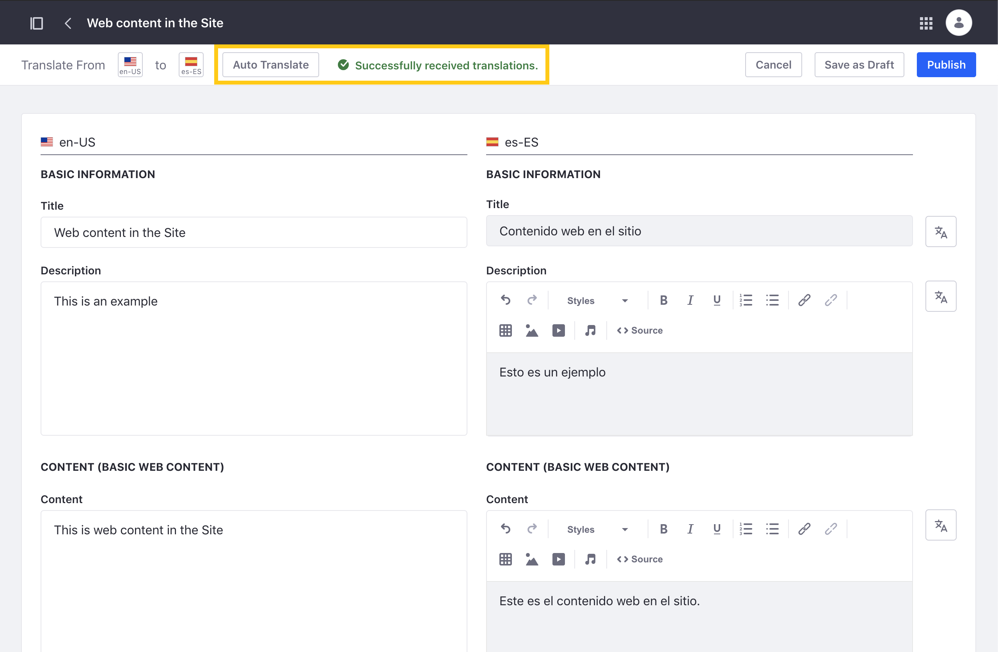
Automatic Translation
Liferay DXP 7.4 also introduces Automatic Translation for web content
By integrating with Google Cloud Translation API, automatic translations are generated for Web Content
Once Automatic Translation enabled, Auto Translate buttons are added to the translation interface for Web Content
Notes:
Notes:
Automatic Translation is enabled in Control Panel > System Settings > Content and Data > Translation (also found under Instance Settings > Content and Data > Translation)
To enable Auto Translate, you will need to provide a valid Google Cloud service account key.
Automatic translation is only available for Web Content. When you open the Translate option for a piece of Web Content, you have two options for Auto Translate:
Auto Translate every Web Content field.
Auto Translate specific Web Content fields.
Use Case:
Mondego can enable Automatic Translation to easily generate Spanish, French, and other versions of Web Content articles. Rather than manually uploading translations for a series of Web Content articles that provide information on different accounts available at Mondego Banks, Auto Translate automatically generates translations.

Slide 44
Use Case Example: Enhancing the Mondego Experience
To improve User Experience on Mondego Sites, the web team implements a plan to improve personalization:
Several Content Pages are updated to include multiple Experiences which are assigned to newly created User Segments
To improve customer service and support, Mondego also:
Integrates with DocuSign to securely collect digital signatures
Enables Click to Chat, allowing customers to directly chat with a representative
Adds Automatic Translation which allows a broader audience to access and engage with web content and information on the Site

Slide 45
Knowledge Check
The Mondego Group can use Experiences to create versions of Content Pages customized to specific User Segments.
Mondego has a larger number of Users that visit the Site from mobile devices. To make sure that pages work for mobile Users, the web team uses the Grid and Container Fragments and defines their layouts for different screen sizes.
To securely collect signatures from Mondego employees and from customers, DocuSign is enabled.
Mondego also improves customer support and Site accessibility by integrating with Click to Chat and enabling Automatic Translation of Web Content.

Slide 46
Knowledge Check
The Mondego Group can use Experiences to create versions of Content Pages customized to specific User Segments.
Mondego has a larger number of Users that visit the Site from mobile devices. To make sure that pages work for mobile Users, the web team uses the Grid and Container Fragments and defines their layouts for different screen sizes.
To securely collect signatures from Mondego employees and from customers, DocuSign is enabled.
Mondego also improves customer support and Site accessibility by integrating with Click to Chat and enabling Automatic Translation of Web Content.

Slide 47
Exercise: Create Unique User Experiences

Slide 48
Create Unique User Experiences Exercise Objectives
Create an Experience for Mondego Employees
Create a New User Segment
Make Changes to the Welcome Page
Add a Custom Navigation Bar to the Welcome Page
Create a Custom Navigation Menu
Use Grid, Dropdown, and Menu Display Fragments to Create a Navigation Bar

Slide 49
Create Unique User Experiences Exercise Steps (1/2)
Create a New Experience on the Mondego Community Welcome Page
Add Conditions to a New User Segment
Group and Define Conditions for the User Segment
Make Changes to the Welcome Page in the Mondego Employees Experience
Set the Mondego Employees Experience Priority
Preview the Mondego Employees Experience

Slide 50
Create Unique User Experiences Exercise Steps (2/2)
Create a Custom Navigation Menu
Add Submenu and URL Elements to the Navigation Menu
Add a Navigation Bar to the Mondego Employees Experience Welcome Page
Add Menu Display Fragments to the Navigation Bar
Configure the Menu Display Fragments
Manage the Fragment Layout for Mobile Devices

Slide 51
Create Unique User Experiences Bonus Exercise
Add a second Experience to the Welcome Page on the Mondego Community Site. Name the New User Segment "Content Creators" and set it to include only those assigned the Site Content Creator Role. Give the Content Creators Experience priority above the Default and Mondego Employees Experiences. Add Fragments and Content to the Welcome Page for that Experience and view those changes.

Slide 52
Summary (1/3)
Fragments and widgets can be used to create Content Pages, which make building engaging web pages both quick and easy with a drag-and-drop creation process.
Master Pages provide a template for headers and footers that can be used on multiple pages on a Site for consistent style and design.
Style Books enable one to make stylistic guidelines for a Site within the confines of the Liferay DXP UI, including managing color scheme, font, and layout.

Slide 53
Summary (2/3)
Experiences are unique versions of a single Content Page that can be targeted at a specific User Segment for a more personalized Site experience.
Adding Custom Navigation Bars improves Site navigation and allows a User to easily navigate to related content.
The Grid and Container Fragments can be customized to display differently depending on the screen size, improving User experience on any device.

Slide 54
Summary (3/3)
By enabling Click to Chat and integrating with one of the supported Chat Providers, a chat window can be added to a Site for added User Support.
Integrating with DocuSign digital signatures allows User signatures to be collected and managed on documents.
Enabling Automatic Translation allows Web Content to be quickly translated using Google Cloud Translation rather than relying on manually added translations.

Slide 55
For Further Reading
For more information on Content Pages and Fragments, consult the documentation here:
https://learn.liferay.com/dxp/latest/en/site-building/creating-pages/building-and-managing-content-pages/content-pages-overview.html
For more information on Master Page Templates and Style Books:
https://learn.liferay.com/dxp/latest/en/site-building/site_appearance.html
To learn more about Creating Unique Digital Experiences with Responsive Layouts, Experiences, and Custom Navigation Menus, visit:
https://learn.liferay.com/dxp/latest/en/site_building.html

Slide 56
For Further Reading
For information on the new features introduced in Liferay DXP 7.4:
DocuSign Digital Signatures: https://learn.liferay.com/dxp/latest/en/content-authoring-and-management/documents-and-media/uploading-and-managing/enabling-docusign-digital-signatures.html
Click to Chat: https://learn.liferay.com/dxp/latest/en/site-building/personalizing-site-experience/enabling-automated-live-chat-systems/enabling-automated-live-chat-systems.html
Automatic Translation: https://learn.liferay.com/dxp/latest/en/content-authoring-and-management/web-content/translating-web-content/automatically-translating-web-content.html

